Slide 1
Course work on theme:
information system to support the sale of vehicles
Lesson: object-oriented programming
Created By: group КС-202, Невмитим О.М.
Head: Docent, candidate of Computer Science Мисник Б.В.

Slide 2
The purpose of this course work
The purpose of this course is to create an application for the support system sales of vehicles, using three basic principles object-oriented programming (OOP), such as:
1. Encapsulation
2. Inheritance
3. Polymorphism

Slide 3
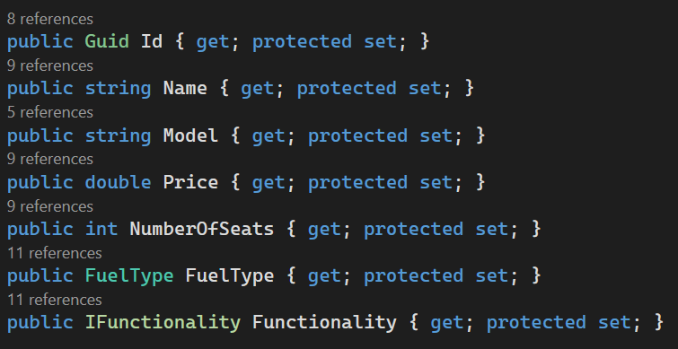
Encapsulation

Slide 4
Inheritance
public abstract class Vehicle {}
public class Car : Vehicle {}
public class Plane : Vehicle {}
public class Bus : Car {}
public class Truck : Car {}
public class Passenger Plane : Plane {}
public class Transport Plane : Plane {}

Slide 5
Polymorphism
public abstract class Vehicle
{
public IFunctionality Functionality { get; protected set; }
public abstract bool CheckFunctionality();
}
public class CarFunctionality : Ifunctionality {}
public class PlaneFunctionality : Ifunctionality {}
public interface IFunctionality
{
bool IsNormalFunctionality();
}
public override bool CheckFunctionality()
{
return Functionality.IsNormalFunctionality();
}

Slide 6
Polymorphism
public interface IInterfaceDataReceiver<T>
{
T GetData();
}
private T GetDataFromList<T>(IEnumerable<object> list)
{
foreach (var control in list)
{
if (control is IInterfaceDataReceiver<T> receiver)
{
return receiver.GetData();
}
}
throw new Exception("User Control is not defined!");
}
public partial class BusCreatUserControl : UserControl, IInterfaceDataReceiver<Vehicle>
{
public Vehicle GetData() {
return new Bus(Guid.NewGuid(), Name.Text,
Model.Text, Convert.ToDouble(Price.Text),
Convert.ToInt32(NumbersOfSeats.Text),
(CarFuel)FuelNameTypeFilter.SelectedItem,
CarFunctionality(),
Convert.ToInt32(PeopleCapacity.Text));}
{

Slide 7
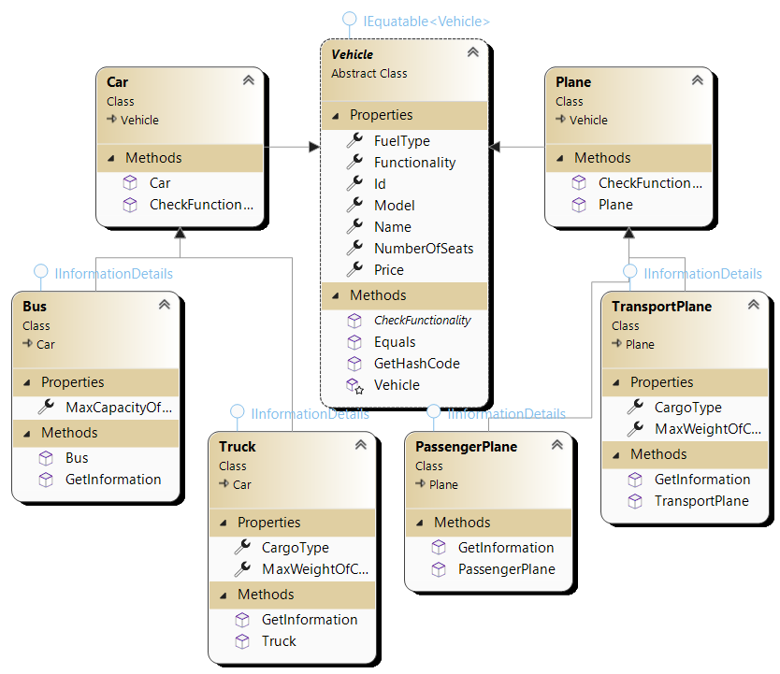
Class Diagram

Slide 8
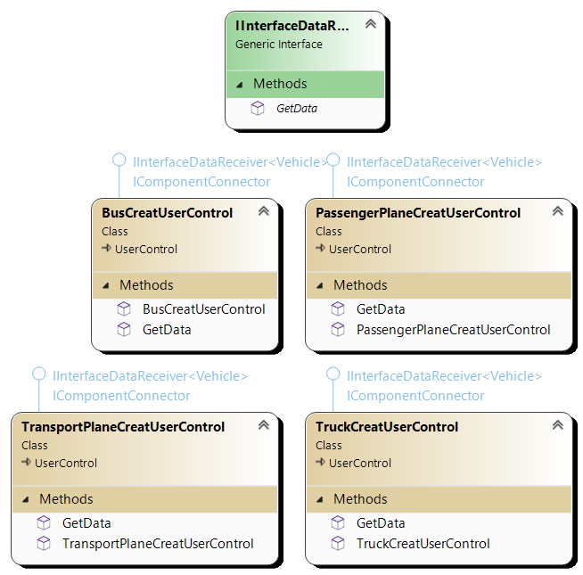
Class Diagram

Slide 9
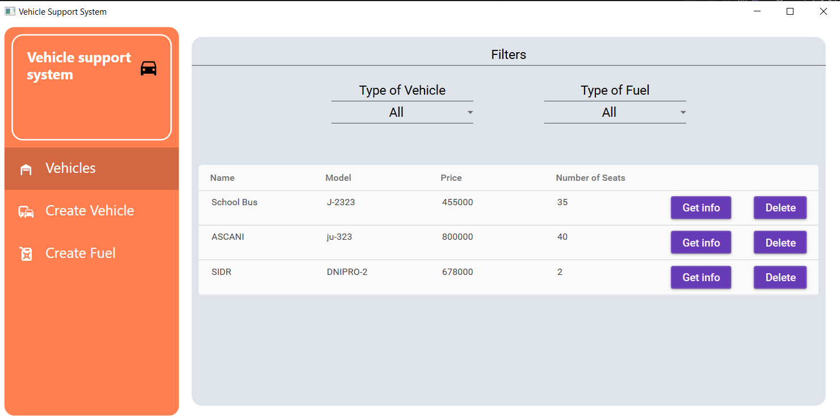
Results of program

Slide 10
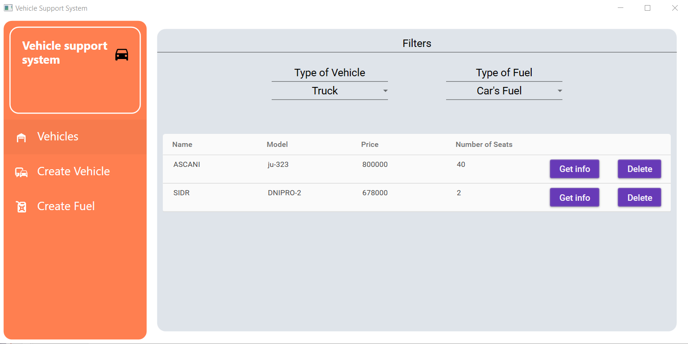
Results of program

Slide 11
☺

